Slide 1

From Bench to Boardroom:
Navigating the Academic Startup Journey
D. Kacy Cullen, Ph.D., Professor of Neurosurgery & Bioengineering
Director, Center for Neurotrauma, Neurodegeneration & Restoration
Corporal Michael J. Crescenz Veterans Affairs Medical Center
Perelman School of Medicine, University of Pennsylvania
DKacy@pennmedicine.upenn.edu http://www.med.upenn.edu/cullenlab/
Radiology Translation and Commercialization Seminar Series, Perelman School of Medicine, UPenn July 14, 2025

Slide 2


Biography
Education
B.S., Mechanical Engineering
Georgia Tech, Atlanta, GA, 2000
M.S., Mechanical Engineering
Georgia Tech, 2002
Ph.D., Biomedical Engineering
Georgia Tech, 2005
Training
Postdoctoral Fellow, Neural Engineering, Georgia Tech,
2005-2006
Postdoctoral Fellow, Neurotrauma
University of Pennsylvania,
2007-2009

Slide 3
Biography
Education
B.S., Mechanical Engineering
Georgia Tech, Atlanta, GA, 2000
M.S., Mechanical Engineering
Georgia Tech, 2002
Ph.D., Biomedical Engineering
Georgia Tech, 2005
Training
Postdoctoral Fellow, Neural Engineering, Georgia Tech,
2005-2006
Postdoctoral Fellow, Neurotrauma
University of Pennsylvania,
2007-2009
Professor of Neurosurgery & Bioengineering, Perelman School of Medicine, University of Pennsylvania (joined Penn faculty in 2009)
Founding Director, Center for Neurotrauma, Neurodegeneration, and Restoration, Corporal Michael Crescenz VA Medical Center
Director, Porcine Neurointensive Care & Assessment Facility, Biomedical Research Building, UPenn
Founding Director, Translational Tissue Engineering & Regenerative Medicine (T-TERM) Fellowship Program, CMC-VAMC & UPenn

Slide 4
Biography
Education
B.S., Mechanical Engineering
Georgia Tech, Atlanta, GA, 2000
M.S., Mechanical Engineering
Georgia Tech, 2002
Ph.D., Biomedical Engineering
Georgia Tech, 2005
Training
Postdoctoral Fellow, Neural Engineering, Georgia Tech,
2005-2006
Postdoctoral Fellow, Neurotrauma
University of Pennsylvania,
2007-2009
Professor of Neurosurgery & Bioengineering, Perelman School of Medicine, University of Pennsylvania (joined Penn faculty in 2009)
Founding Director, Center for Neurotrauma, Neurodegeneration, and Restoration, Corporal Michael Crescenz VA Medical Center
Director, Porcine Neurointensive Care & Assessment Facility, Biomedical Research Building, UPenn
Founding Director, Translational Tissue Engineering & Regenerative Medicine (T-TERM) Fellowship Program, CMC-VAMC & UPenn
Why Academic Research?
Freedom to work across the spectrum from discovery to application
Training the Next Generation: mentoring students, postdocs, and junior faculty
Teaching: Bioengineering “From Lab to Marketplace” and Neuroscience “Nervous System Injury & Repair”

Slide 5



Disclosure of Major Translational Activities
I am an inventor on >25 patents, with issued patents in the U.S., E.U., Japan, and Australia. Patents are owned by the University of Pennsylvania and/or the Department of Veterans Affairs.
I am also a scientific co-founder of Axonova Medical, Innervace, and Neurostorative, UPenn spinout companies created to translate advanced regenerative strategies for central nervous system reconstruction, neuromuscular regeneration, and peripheral nerve repair.
These potential conflicts-of-interest are managed by the University of Pennsylvania.

Slide 6
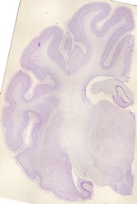
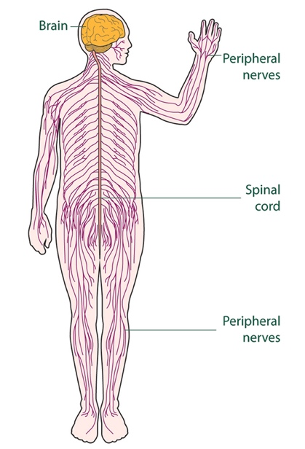

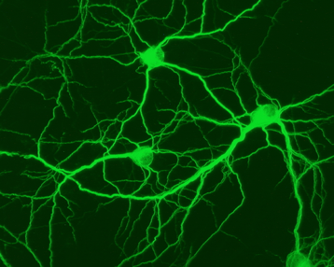
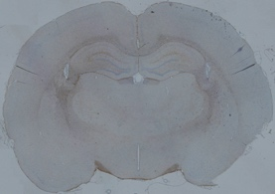

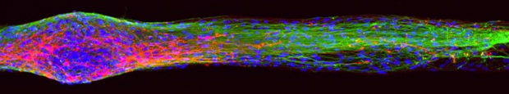
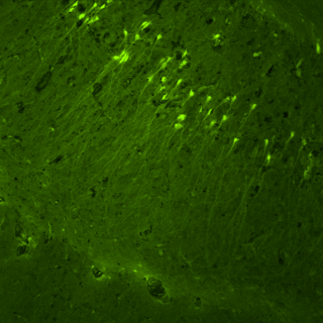
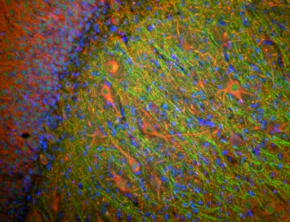
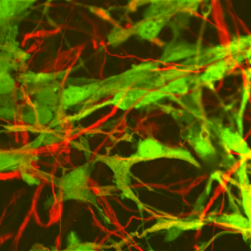
Cullen Lab - Research Areas
Advanced Regenerative Therapies: Biologics, Engineered Tissue, Biohybrid Neural Interfaces
Neurotrauma: Traumatic Brain Injury, Spinal Cord Injury & Peripheral Nerve Injury
We apply a multi-level approach which includes anatomically-inspired tissue engineering, rodent models,
and porcine models to create a translational pipeline.
Goal: improve our understanding of neurotrauma and neurodegenerative disorders while developing engineering therapeutics to facilitate tissue reconstruction, regeneration, and functional recovery
INCREASING COMPLEXITY
Cell and Tissue Manufacturing
Engineered Tissue
Small Animal Models
Large Animal Models
Clinical Use
nts

Slide 7
Outline
Role of academic labs in translational biomedical research
Stages of translational research (pre-clinical, clinical, etc.)
Key principles related to intellectual property, material transfer agreements and interfacing with Technology Transfer office(s)
Funding mechanisms for translational research
Strategies to expedite translational research
Notes:
TRRA-1

Slide 8
Outline
Role of academic labs in translational biomedical research
Stages of translational research (pre-clinical, clinical, etc.)
Key principles related to intellectual property, material transfer agreements and interfacing with Technology Transfer office(s)
Funding mechanisms for translational research
Strategies to expedite translational research
Notes:
TRRA-1

Slide 9
Role of Academic Labs in Translational Research
Adapted from Steinmetz & Spack, The basics of preclinical drug development for neurodegenerative disease indications, BMC Neurology 9 (Supp 1): S2 (2009)

Slide 10
Role of Academic Labs in Translational Research
Industry
Adapted from Steinmetz & Spack, The basics of preclinical drug development for neurodegenerative disease indications, BMC Neurology 9 (Supp 1): S2 (2009)

Slide 11
Role of Academic Labs in Translational Research
Academia
Industry
Adapted from Steinmetz & Spack, The basics of preclinical drug development for neurodegenerative disease indications, BMC Neurology 9 (Supp 1): S2 (2009)

Slide 12
Role of Academic Labs in Translational Research
Academia
?
Industry
Adapted from Steinmetz & Spack, The basics of preclinical drug development for neurodegenerative disease indications, BMC Neurology 9 (Supp 1): S2 (2009)

Slide 13
Outline
Role of academic labs in translational biomedical research
Stages of translational research (pre-clinical, clinical, etc.)
Key principles related to intellectual property, material transfer agreements and interfacing with Technology Transfer office(s)
Funding mechanisms for translational research
Strategies to expedite translational research
Notes:
TRRA-1

Slide 14
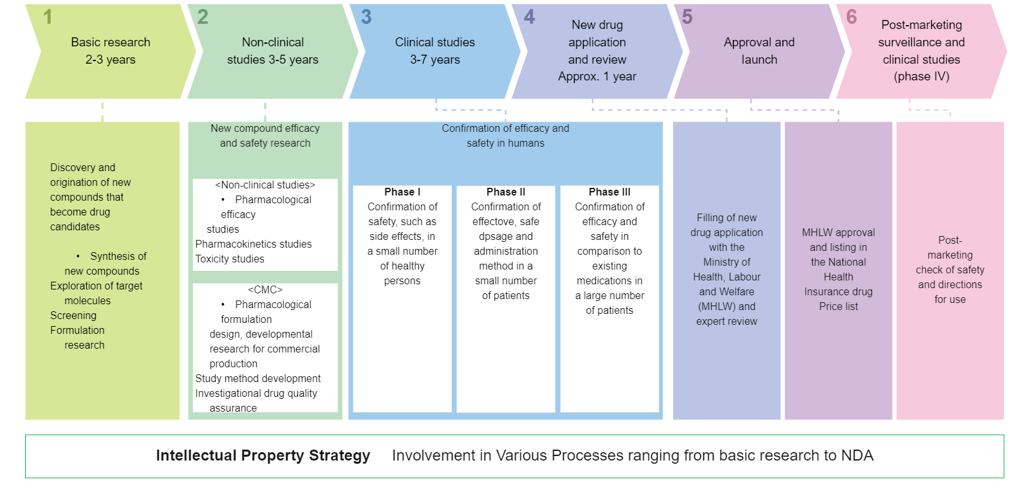
Stages of Translational Research

Slide 15
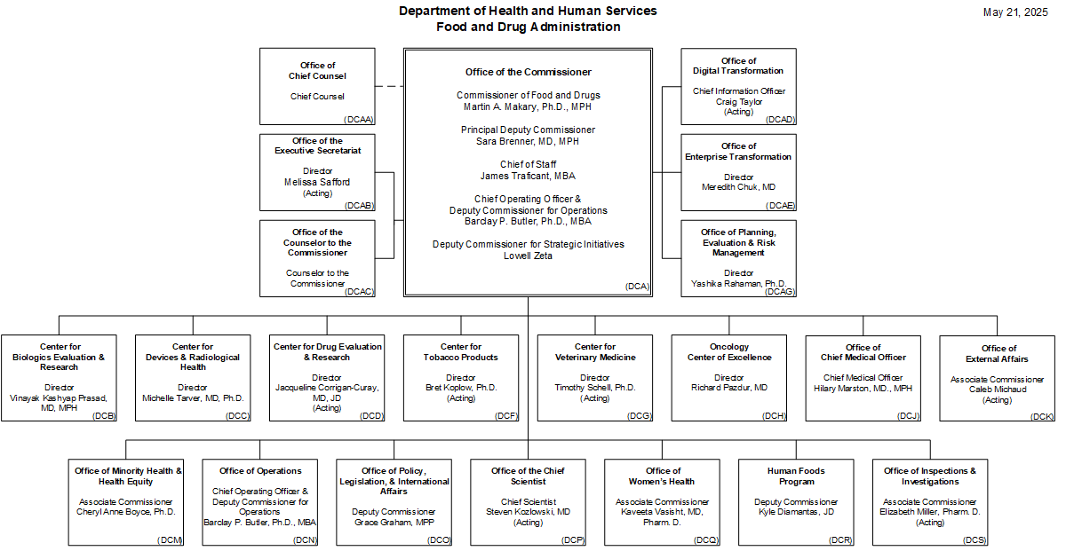
Stages of Translational Research

Slide 16
Stages of Translational Research

Slide 17
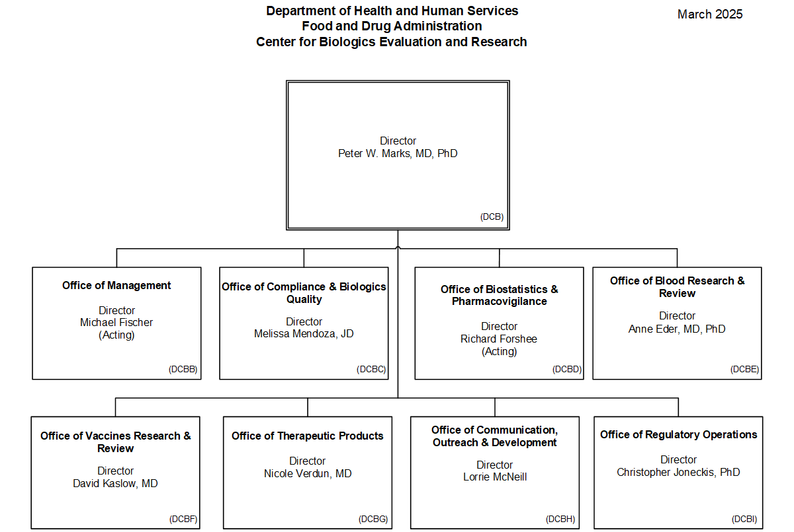
Stages of Translational Research

Slide 18
Stages of Translational Research

Slide 19
Outline
Role of academic labs in translational biomedical research
Stages of translational research (pre-clinical, clinical, etc.)
Key principles related to intellectual property, material transfer agreements and interfacing with Technology Transfer office(s)
Funding mechanisms for translational research
Strategies to expedite translational research
Notes:
TRRA-1

Slide 20
Technology Transfer
Intellectual Property Protection
Patents: novel, useful, non-obvious
Trade Secrets
Copyrights & Trademarks

Slide 21
Technology Transfer
Intellectual Property Protection
Patents: novel, useful, non-obvious
Trade Secrets
Copyrights & Trademarks
Material Transfer Agreements
Collaborating Labs
Industry Partners

Slide 22
Technology Transfer
Intellectual Property Protection
Patents: novel, useful, non-obvious
Trade Secrets
Copyrights & Trademarks
Material Transfer Agreements
Collaborating Labs
Industry Partners
Technology Transfer Office(s)
Disclosure: go / no-go?
Provisional → Full Application & PCT (International) Application
Examination and Issued Claim(s)

Slide 23
Outline
Role of academic labs in translational biomedical research
Stages of translational research (pre-clinical, clinical, etc.)
Key principles related to intellectual property, material transfer agreements and interfacing with Technology Transfer office(s)
Funding mechanisms for translational research
Strategies to expedite translational research
Notes:
TRRA-1

Slide 24
Funding Mechanisms for Translational Research
Adapted from Steinmetz & Spack, The basics of preclinical drug development for neurodegenerative disease indications, BMC Neurology 9 (Supp 1): S2 (2009)

Slide 25
Funding Mechanisms for Translational Research
Adapted from Steinmetz & Spack, The basics of preclinical drug development for neurodegenerative disease indications, BMC Neurology 9 (Supp 1): S2 (2009)

Slide 26
Funding Mechanisms for Translational Research
NIH
R61/R33 – IGNITE, Device, others…
Blueprint Neurotherapeutics
U01 vs R01?
VA
TDA Stage 0, 1 & 2
BRAVE
DoD: TRL specific; MRMC / CDMRP
SBIR & STTR
NIH, NSF, DoD, others
Adapted from Steinmetz & Spack, The basics of preclinical drug development for neurodegenerative disease indications, BMC Neurology 9 (Supp 1): S2 (2009)

Slide 27
SBIR/STTR – NIH, NSF, DoD, and others
Provides non-dilutive funding to develop your technology and chart a path toward commercialization.
https://www.sbir.gov/
https://seed.nih.gov/small-business-funding/find-funding/sbir-sttr-funding-opportunities
Phase 1 – Proof of concept
$50,000 - $275,000 over 6-12 months
Phase 2 – Technology development
Greater focus on business plan
$750,000 - $1.8 million over 2 years
SBIR – awarded to an independent small business
STTR – awarded to university/PI to spin out a business

Slide 28
VA Translational Development Award (Stage 0-2)
Purpose: provide support that is unavailable through existing funding mechanisms to de-risk new interventional products to a sufficient extent such that translation to commercial/clinical availability becomes viable
Stage 0 – De-risking through replication, validation, optimization
$150,000/year for 2 years
Stage 1 – Lead isolation, administration route, PK/PD; Prep for pre-IND/IDE meeting with FDA
$250,000/year for up to 4 years
Stage 2 – milestone-driven evaluation of therapeutic agents/devices to obtain approvals to conduct human studies, and in some cases conduct those studies
$1,000,000/year for up to 5 years

Slide 29
Outline
Role of academic labs in translational biomedical research
Stages of translational research (pre-clinical, clinical, etc.)
Key principles related to intellectual property, material transfer agreements and interfacing with Technology Transfer office(s)
Funding mechanisms for translational research
Strategies to expedite translational research
Notes:
TRRA-1

Slide 30
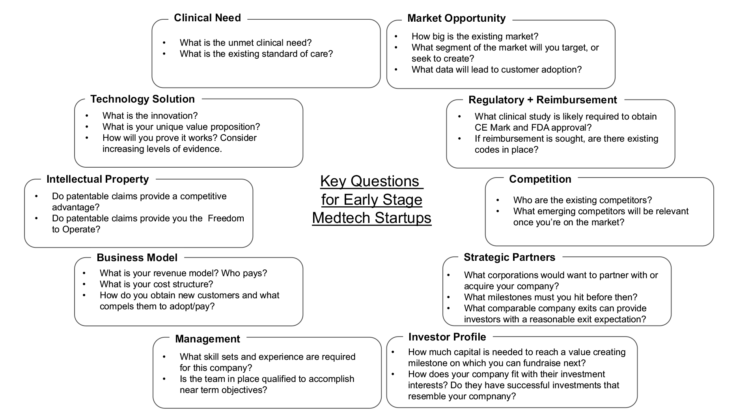
Major Translational Activities
Adapted from Mas & Hsueh, An investor perspective on forming and funding your medical device start-up, Techniques in Vascular and Interventional Radiology 20: 101-108 (2017)

Slide 31
Major Translational Activities
Adapted from Mas & Hsueh, An investor perspective on forming and funding your medical device start-up, Techniques in Vascular and Interventional Radiology 20: 101-108 (2017)

Slide 32
Major Translational Activities
Adapted from Mas & Hsueh, An investor perspective on forming and funding your medical device start-up, Techniques in Vascular and Interventional Radiology 20: 101-108 (2017)

Slide 33
Major Translational Activities
Adapted from Mas & Hsueh, An investor perspective on forming and funding your medical device start-up, Techniques in Vascular and Interventional Radiology 20: 101-108 (2017)

Slide 34
Major Translational Activities
Adapted from Mas & Hsueh, An investor perspective on forming and funding your medical device start-up, Techniques in Vascular and Interventional Radiology 20: 101-108 (2017)

Slide 35
Major Translational Activities
Adapted from Mas & Hsueh, An investor perspective on forming and funding your medical device start-up, Techniques in Vascular and Interventional Radiology 20: 101-108 (2017)

Slide 36
Major Translational Activities
Adapted from Mas & Hsueh, An investor perspective on forming and funding your medical device start-up, Techniques in Vascular and Interventional Radiology 20: 101-108 (2017)

Slide 37
Major Translational Activities
Adapted from Mas & Hsueh, An investor perspective on forming and funding your medical device start-up, Techniques in Vascular and Interventional Radiology 20: 101-108 (2017)

Slide 38
Major Translational Activities
Adapted from Mas & Hsueh, An investor perspective on forming and funding your medical device start-up, Techniques in Vascular and Interventional Radiology 20: 101-108 (2017)

Slide 39
Major Translational Activities
Adapted from Mas & Hsueh, An investor perspective on forming and funding your medical device start-up, Techniques in Vascular and Interventional Radiology 20: 101-108 (2017)

Slide 40
Major Translational Activities
Adapted from Mas & Hsueh, An investor perspective on forming and funding your medical device start-up, Techniques in Vascular and Interventional Radiology 20: 101-108 (2017)

Slide 41
Summary: Strategies to Expedite Translational Research
Start with end goal in mind
Assess unmet need
IP – think ahead
Streamline biomanufacturing and testing
Make Target Product Profile (TPP)
Leverage diverse funding mechanisms
Engage stakeholders
Notes:
TRRA-1

Slide 42
Outline
Role of academic labs in translational biomedical research
Stages of translational research (pre-clinical, clinical, etc.)
Key principles related to intellectual property, material transfer agreements and interfacing with Technology Transfer office(s)
Funding mechanisms for translational research
Strategies to expedite translational research
Notes:
TRRA-1

Slide 43
From Biomedical Science to the Marketplace (BE 5020)
Developed and led course since 2018
Investigates strategies for “Bioengineering Entrepreneurship” and is popular with Bioengineering, Wharton, Nursing, and Law students.
Course explores transition from fundamental biomedical knowledge to technology/therapy development to the ultimate application as a clinical device, drug, and/or biological agent.
Emphasis is placed upon factors that influence this transition, including intellectual property, federal regulatory process, entrepreneurial strategies, and cross-disciplinary knowledge for commercial success.

Slide 44
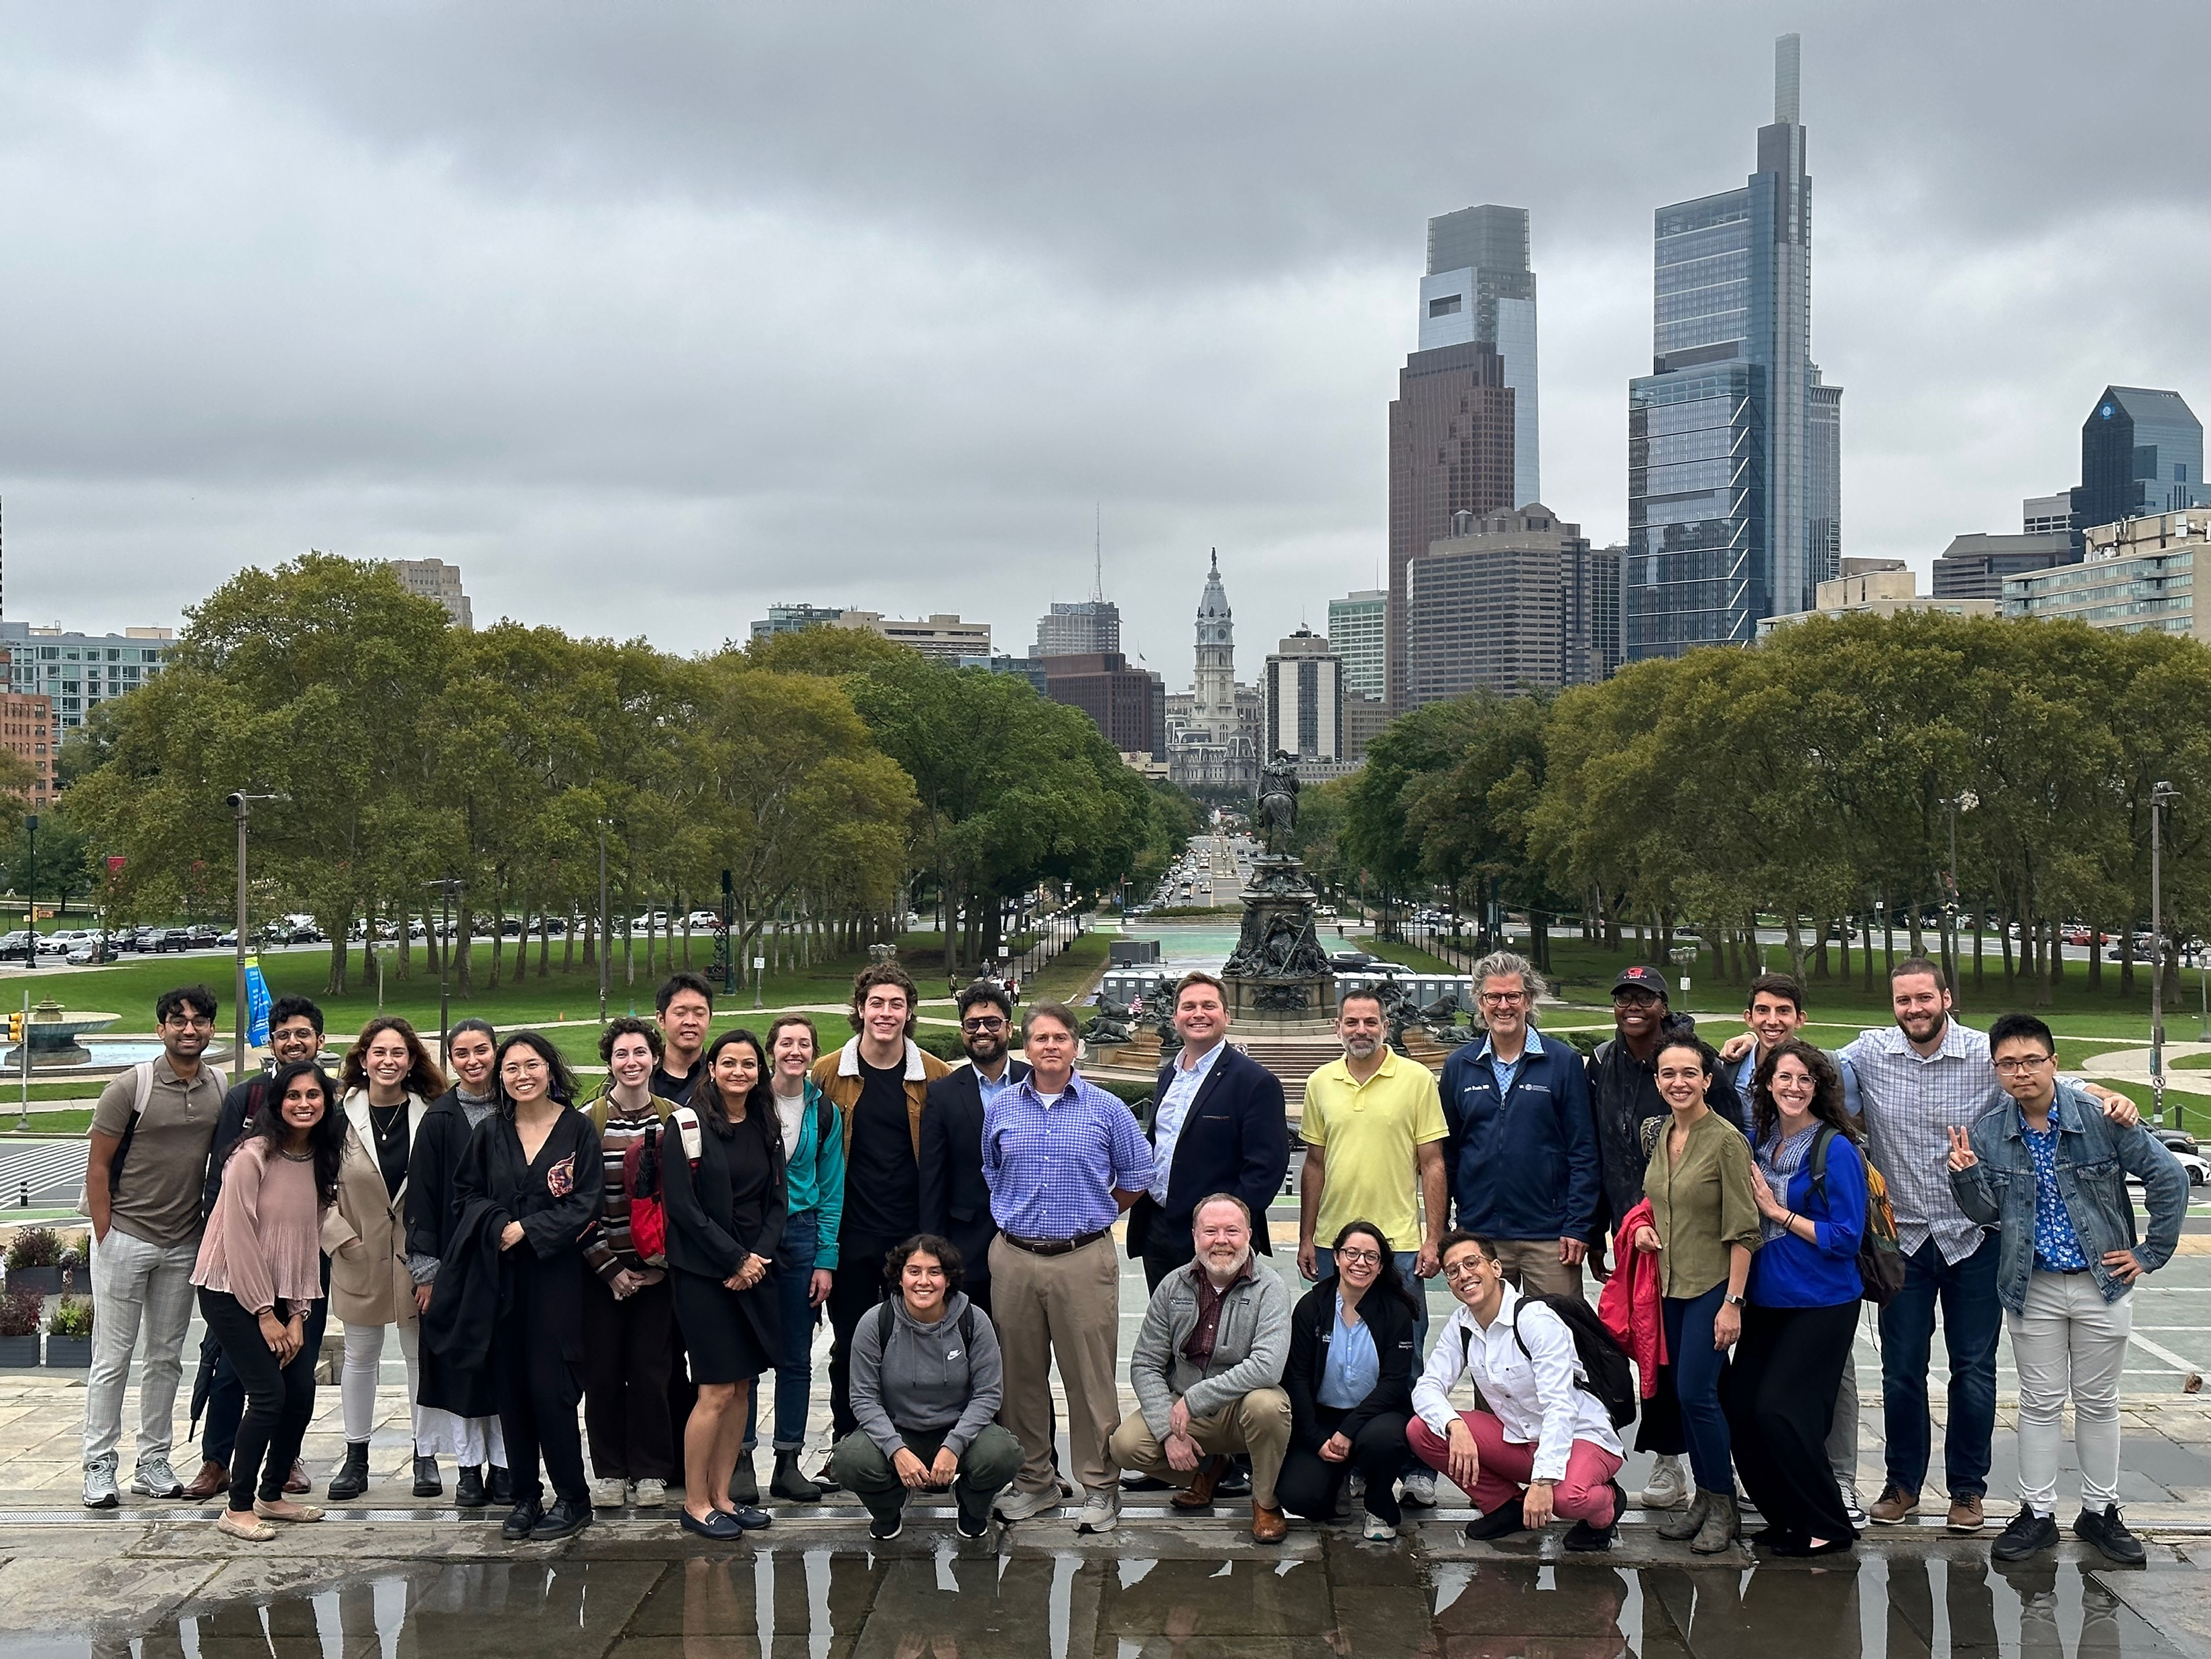
Acknowledgements
Funding
National Institutes of Health
Dept. of Veterans Affairs
Dept. of Defense
Advanced Research & Invention Agency (UK)
Michael J. Fox Foundation
Howard Hughes Medical Institute
Commonwealth of PA
University of Pennsylvania

Slide 45
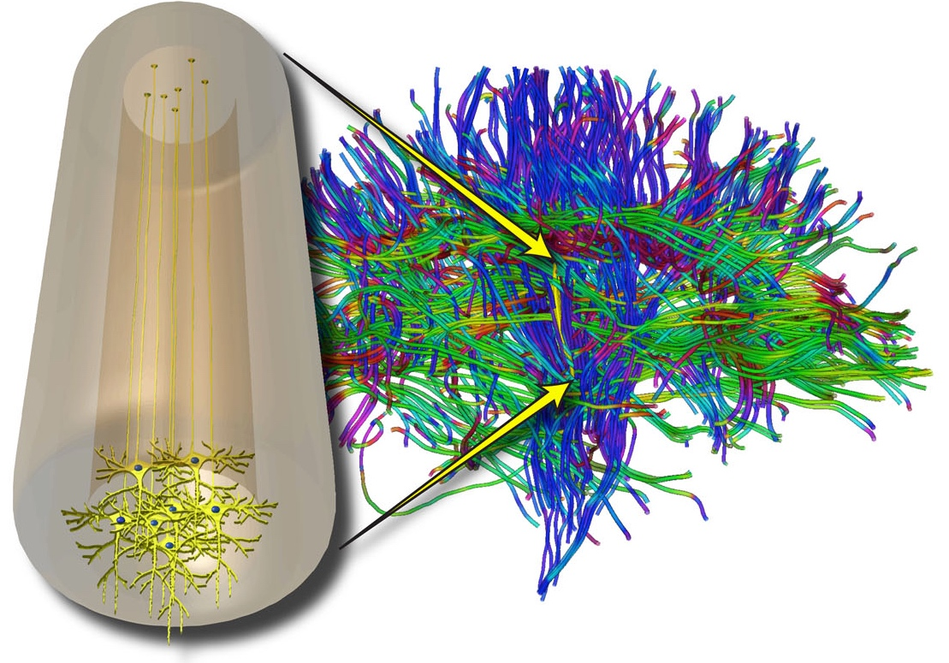
Questions?

Slide 46
Advanced Therapies for Restorative Neurosurgery
The future of restorative neurosurgery will be defined by advanced regenerative therapies capable of eliciting functional recovery in patients with currently intractable conditions such as severe neurotrauma (e.g., brain, spinal cord, or nerve injury) or neurodegenerative disease (e.g., Parkinson’s or Alzheimer’s).
This paradigm shift will be aided by the development of first-in-class tissue engineered medical products (TEMPs) designed to facilitate nervous system reconstruction in well-defined patient populations.
Our group applies bioengineering design principles and cutting-edge biofabrication techniques to create living TEMPs that mimics the form and function of anatomically-defined facets of the nervous and/or neuromuscular system.
This suite of TEMPs is designed to augment the body’s capacity for regeneration by directly replacing lost tissue and/or leveraging developmental mechanisms for tissue reconstruction.

Slide 47
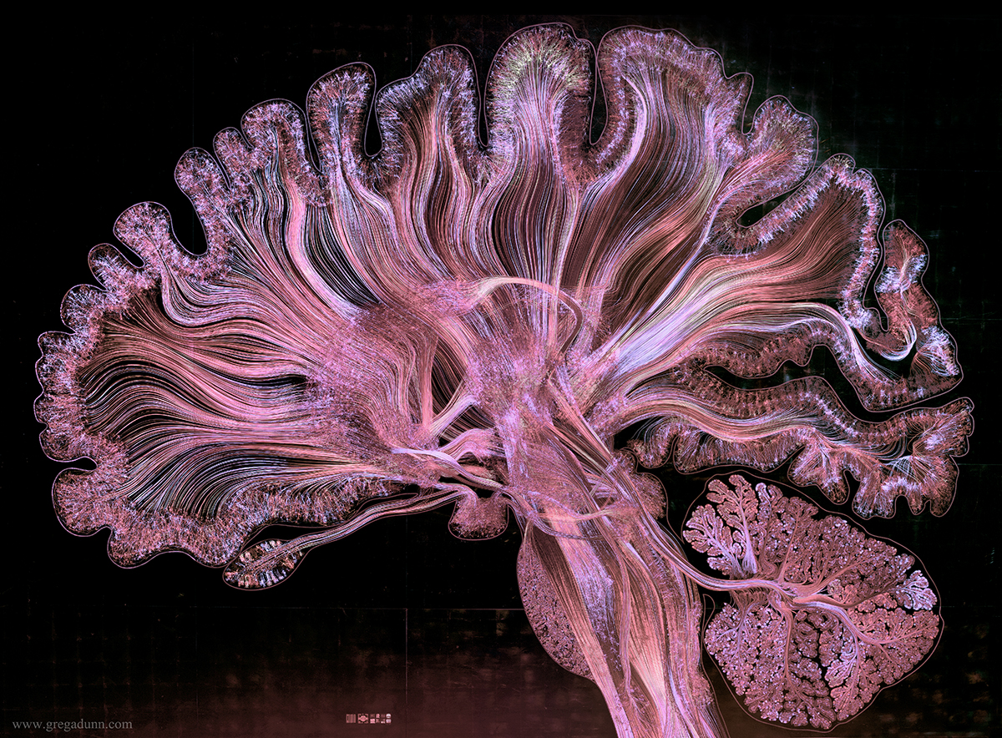
The Unmet Need – There is No Current Strategy Capable of Rebuilding Brain Circuitry
Brain circuitry disruption underlies the neurological deficits caused by a host of nervous system disorders and diseases, including TBI, stroke and Parkinson’s disease
Our solutions: Implantable, tissue engineered brain pathways to reconstruct lost brain circuitry on a per-patient basis

